Slide 1

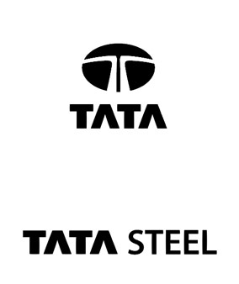
MANAGEMENT TRAINEE SERVICES
Project: Increase in the Reliability of the Braking Pinch Roll Assembly
INTERN: Mr. RISHI RAJ
GUIDE: Mr. SANJAY KUMAR VERMA
OFFICE: NEW BAR MILL, TATA STEEL, JAMSHEDPUR

Slide 2


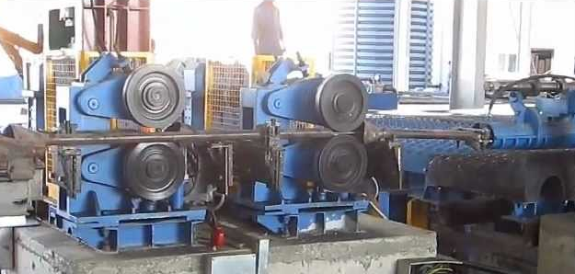
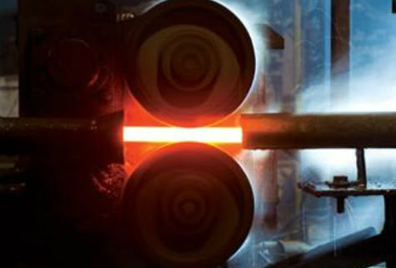
Braking Pinch Roll
A braking pinch roll is a mechanical device used to control and slow down moving material.
Principle:
It consists of two counter-rotating rollers positioned close together.
By applying pressure, these rollers can grip the material passing between them.
The friction between the rollers and the material creates a braking force that opposes the material's movement.
Function:
Their primary function is to decelerate or stop moving material, such as sheets of metal or bars. This can be done for various reasons:
Controlled feeding: Pinch rolls can maintain a steady tension on the material as it moves through processing stages.
Stopping: They can bring the material to a complete halt at specific points in the line.
Tail braking: In high-speed processes, they can prevent the tail end of the material from accelerating after leaving a processing stage.
Fig 1: Braking Pinch Roll Assembly
Fig 2: Braking Pinch Roll Functioning

Slide 3
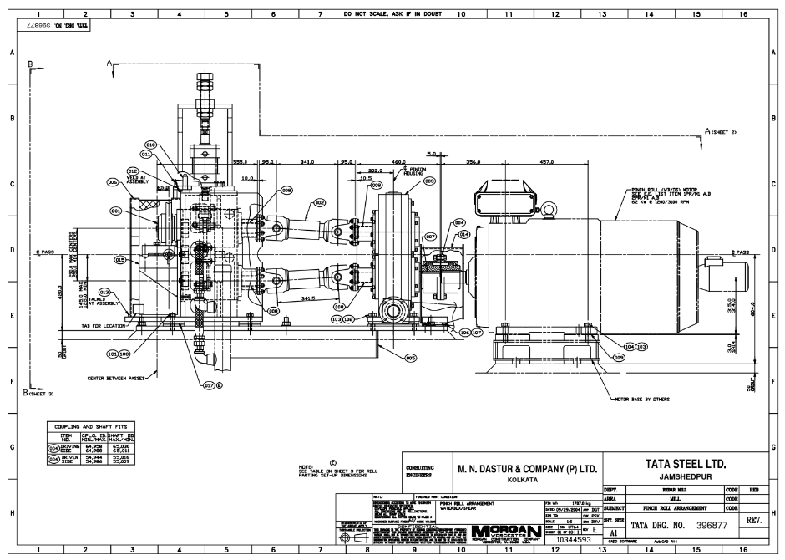
Braking Pinch Roll Arrangement
Fig 1: Overview Drawing of A Braking Pinch Roll Arrangement Drawn on AutoCAD

Slide 4
Pinch Roll And Braking Pinch Roll
Features | Pinch Roll | Braking Pinch Roll
Primary Function | Used for gripping and feeding material. | Designed to slow down or stop moving material.
Applications | In various scenarios where material needs to be guided, positioned, or fed through a process. | Particularly in metal processing lines (rolling mills) and conveyor systems.
Braking Force | May or may not have a braking mechanism. If have, this will produce low braking force. | High Braking Force as this is the core function.
Design and Actuation | Generally simpler design with less robust construction. | More robust design and construction to handle the higher braking forces.

Slide 5
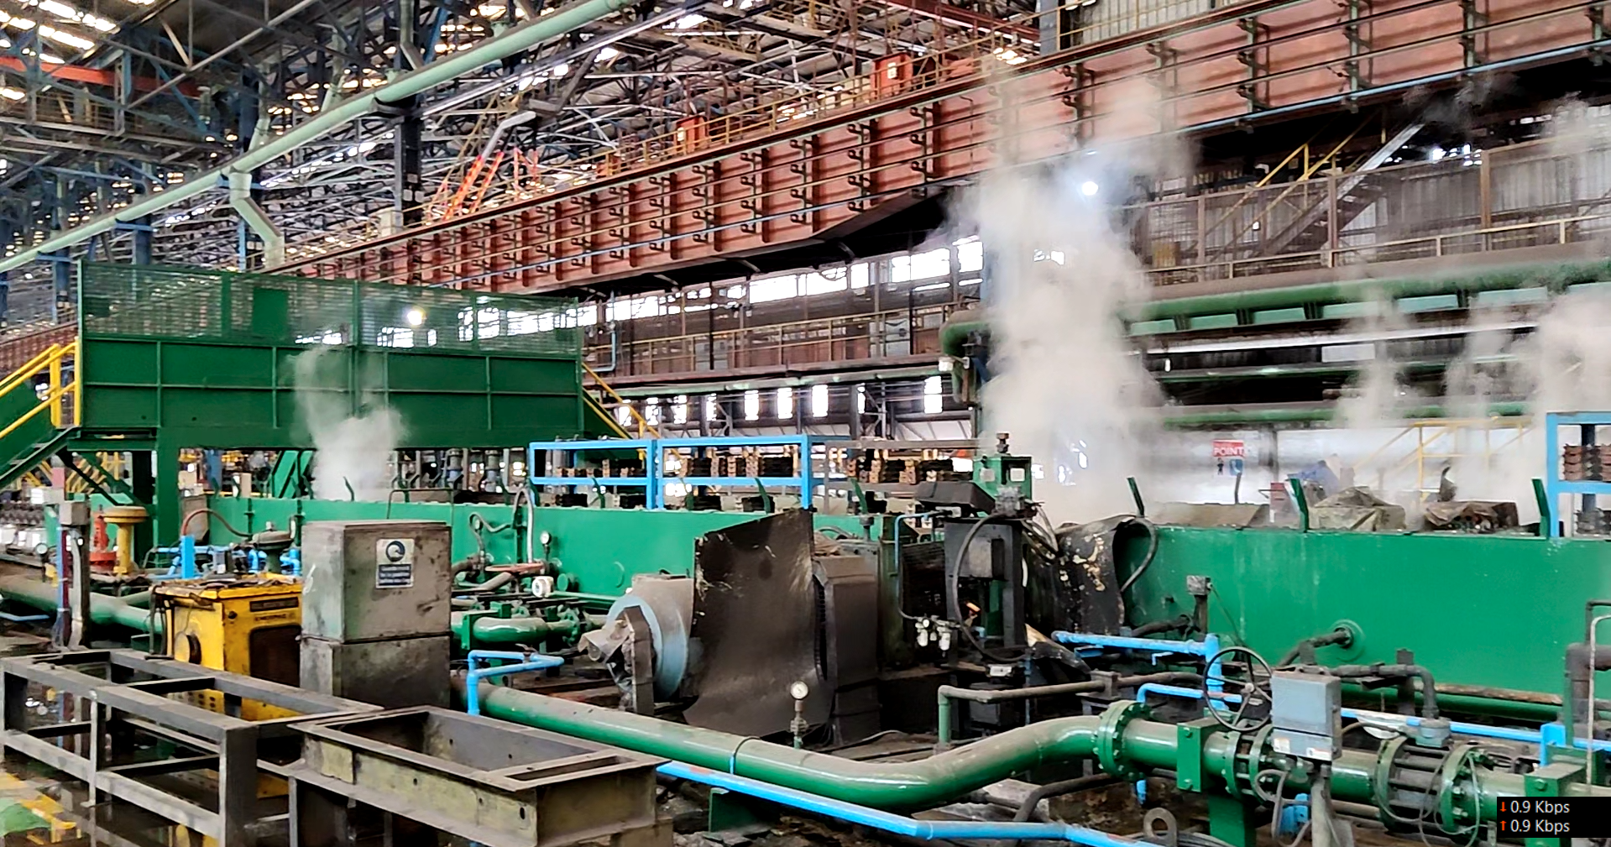
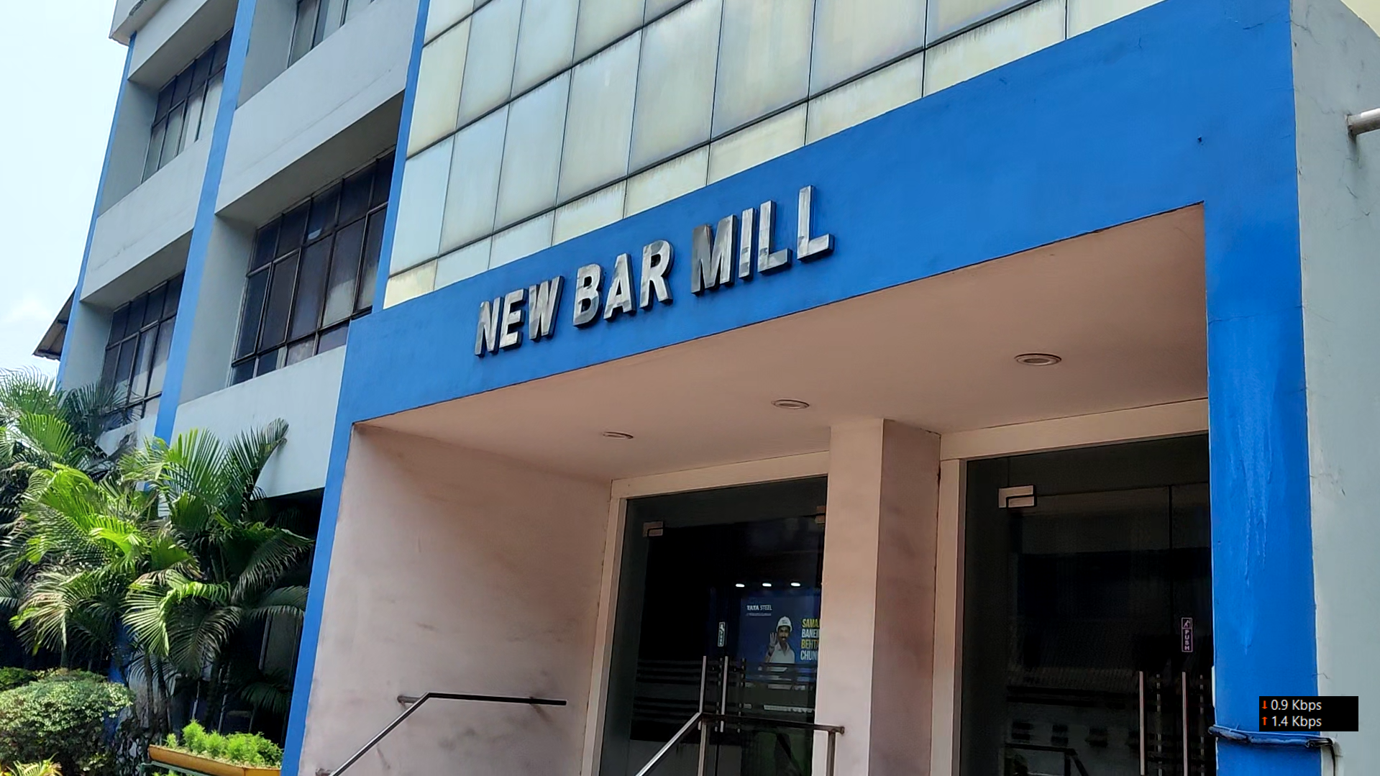
New Bar Mill
Overview Of New Bar Mill Manufacturing Plant:-
New Bar Mill was a part of the 3-million-ton expansion plan of Tata Steel Jamshedpur.
The raw material for NBM is steel billets of 150mm × 150 mm cross-section from LD#1 CC#2.
Billets are reheated in the walking beam furnace and are rolled in single strand through 1V to 16H and are slit 2 ways and rolled through two groups of No Twist mill strands 17 through 22.
The final product of the NBM are rebars of 10mm, 12mm and 16mm cross-section.
Fig 3: Inside Manufacturing Plant Of New Bar Mill, TSL
Fig 4: New Bar Mill Office, TSL

Slide 6
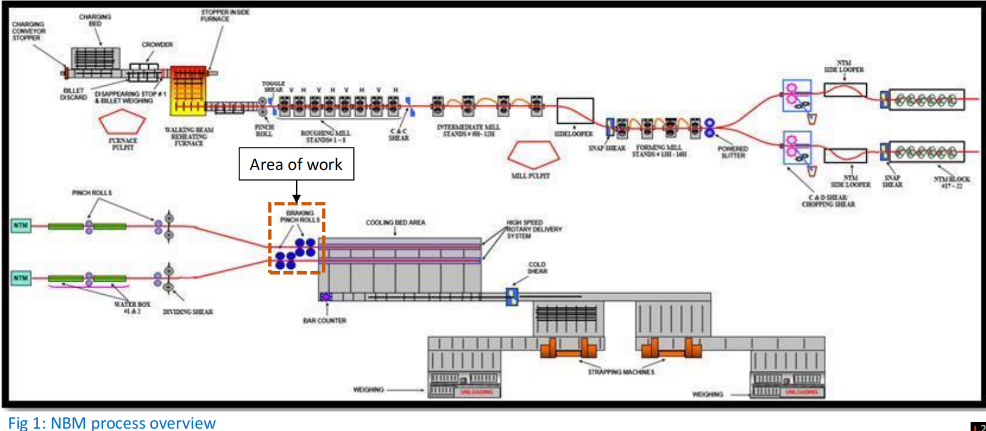
New Bar Mill
Process Overview with pointing location of area where I am working.
Area of work
Fig 5: New Bar Mill Process Overview

Slide 7
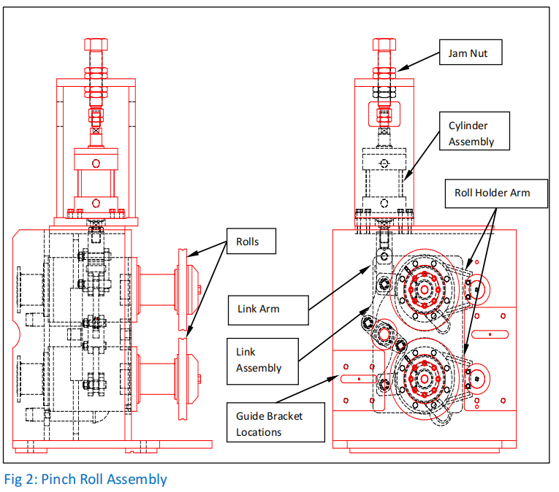
Bar Braking Pinch Rolls
The four-bar braking pinch rolls are located after the dividing shear and before the high-speed entry equipment to the cooling bed. Each strand has two identical braking pinch rolls.
The pinch roll consists of upper and lower rolls that are driven by a speed regulated motor having a gear ratio of 1:1.
Rolls are closed using a pneumatic cylinder with force controlled by a pressure regulator.
Linkage within the pinch roll unit causes each roll to move an equal distance in opposite directions.
Purpose of Braking Pinch Rolls:
Braking pinch rolls are used to both stabilize the stock during rolling and to control the rod slow down and stopping position of the bar entering the rotary drums.
Fig 6: Bar Braking Pinch Rolls Assembly

Slide 8
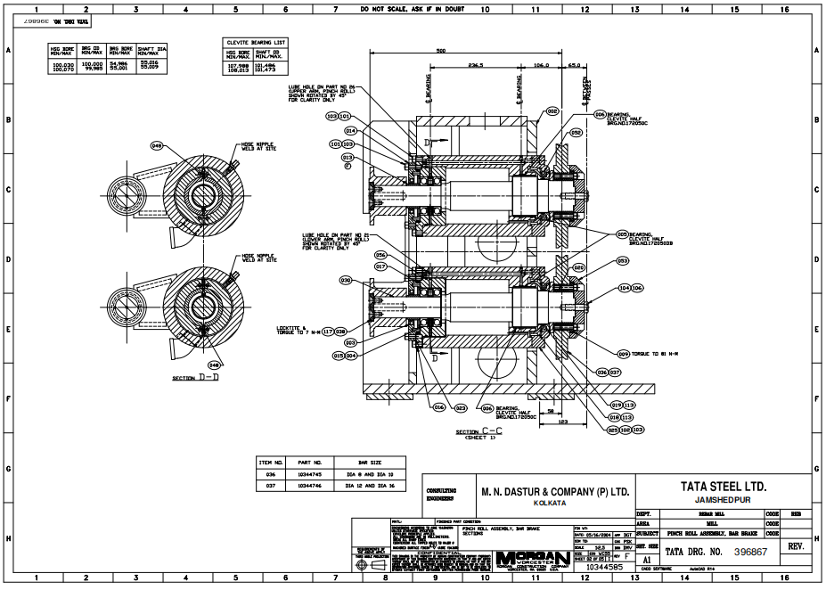
Bar Braking Pinch Rolls
Fig 7: Top View Drawing of Bar Braking Pinch Rolls Assembly drawn in AutoCAD

Slide 9
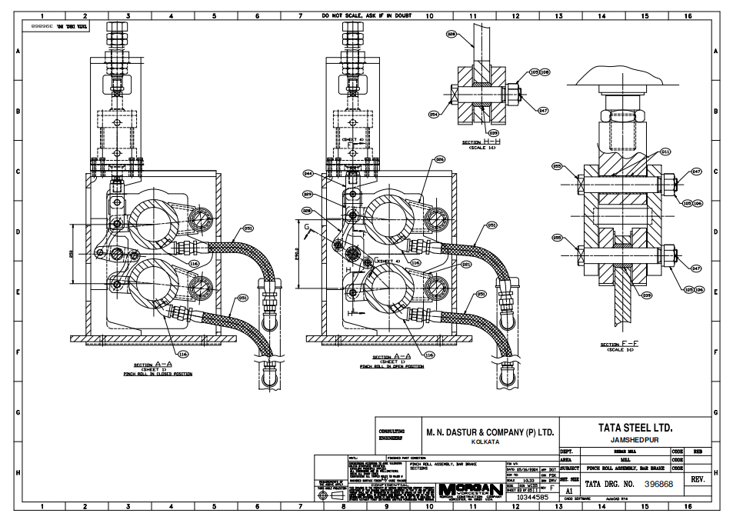
Bar Braking Pinch Rolls
Fig 7: Overview Drawing also shown the how Bar Braking Pinch Rolls Assembly works, drawn in AutoCAD

Slide 10
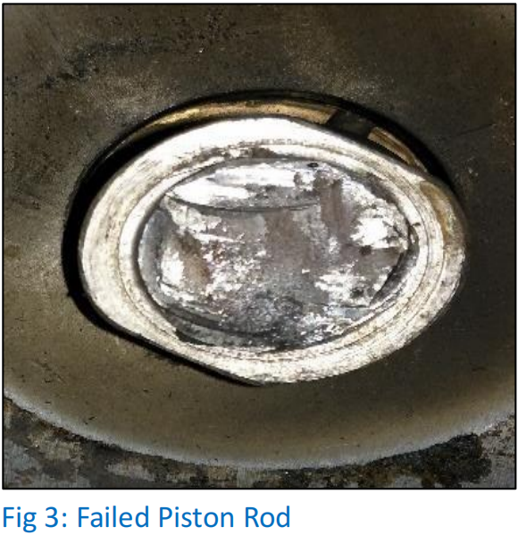
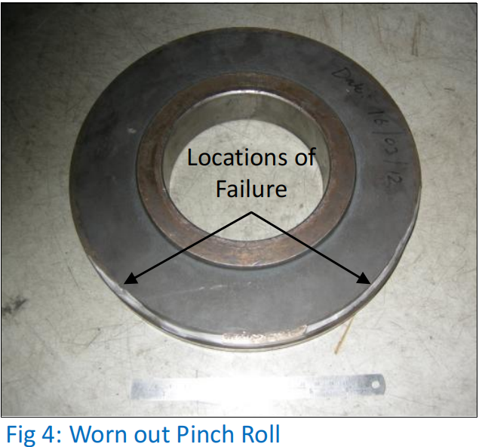
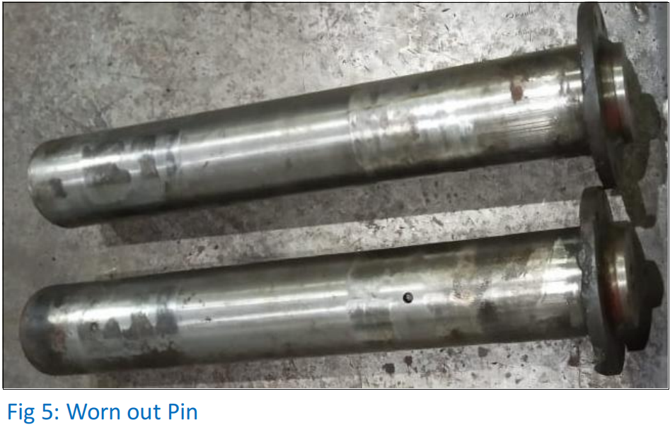
Problem Definition
The issues of the pinch roll assembly reliability at New Bar Mill, TSJ which have been analyzed during the tenure of this internship are:-
Piston Rod Failure – Piston rod of the pneumatic cylinder is failing prematurely from the neck of the threading.
Wearing of Pinch Rolls – Due to continuous operations at a high temperature, the pinch rolls wear out and the groove on the outer surface of the pinch rolls enlarges overtime.
Play between Top & Bottom Cartridge – The pin about which the eccentric cartridges pivots is wearing out which causes play between the pinch rolls.
Fig 8: Failed Piston Rod
Fig 9: Worn Out Pinch Roll
Fig 10: Worn Out Pin

Slide 11
Problem Measurement
Pinch Roll has been a major cause of delay at the NBM.
Piston rod failure accounted for maximum delay throughout last year.
• Source of data – NBM RYMS
• Period of data – 01/04/2023 to 31/03/2024
Project Area
BPRA1 cylinder piston rod broken
WBPRA & B malfunctioning

Slide 12
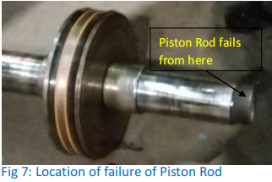
Piston Rod
Problem Analysis:
On analysis of the fractured surface of piston rod it was revealed that the mode of failure was fatigue mode.
According to design calculations the piston rod should not fail for the theoretical loading condition and have a life of more than 106 cycles.
However, due to the presence of bending load on the piston rod, it failed prematurely.
DESIGN CALCULATIONS
p
Pressure
Bore Diameter
Rod Diameter
Dia. Of Min. Section
Force
Stress Generated
Endurance Limit
6 bar
152.4 mm
44.6mm
28.5mm
10011.7mm
61.2MPa
104.3MPa
Piston Rod not able to
endure the stresses
generated
Why?
Diameter of rod & size of
threading not adequate.
Root Cause
Problem
Bending load acts on piston rod which makes its design unreliable
Piston Rod Failure
Why?
Unexpected forces acting
on piston rod.
Why?
Bending forces acting due
to improper assembly.
Fig 11: Root Cause Analysis for Piston Road Failure
Fig 12: Location of Failure of Piston Rod

Slide 13
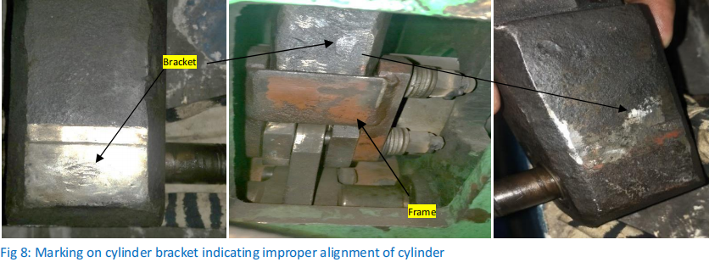
Recommended Solutions:
From the root cause analysis, we can infer that the reason for failure of piston rod is the presence of
unexpected bending load acting on the piston rod. Therefore, the life of the piston rod can be increased in the
following ways:-
Improve Assembly Procedure – One of the possible reasons for increased bending load can be improper alignment of cylinder. Hence the assembly process needs to be checked to minimize the bending load acting on the piston rod.
Increase Piston Rod Diameter – If the diameter of the rod is increased size of the threading at the ends also increases. This reduces the stress generated at the minor diameter of the thread thereby increasing the life of piston rod.
New Piston Rod Inspection – Dye penetrant inspection and ultrasonic inspection of new piston rods should be done to identify any surface or internal cracks which can lead to sudden failure of piston rod.
Fig 13: Marking on cylinder bracket indicating improper alignment of cylinder

Slide 14
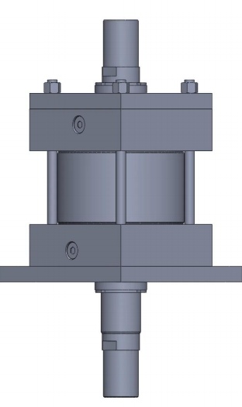
New Pneumatic Cylinder
The Parker Series 2A pneumatic cylinder is a heavy-duty, industrial-grade cylinder designed for use in demanding environments. Here's a breakdown of its key features to help you study it effectively:-
1.Design:-
Tie-Rod Construction: This design uses high-strength tie rods to hold the cylinder body and end caps together.
Steel body and end caps: Makes it resistant to high temperatures, impacts, and harsh environments.
Hard Chrome Plated Piston Rod: Hard, wear-resistant surface protects from scratches and corrosion.
“Jewel” Rod Glands: Unique Parker design that minimizes friction and leakage.
Adjustable floating cushions: These cushions absorb shock at the end of the stroke, reduced noises.
2.Operations:-
Double Acting: The Series 2A cylinder can be extended and retracted using compressed air supplied to either port.
Lubricated Air: Designed to operate with lubricated air to ensure proper lubrication of the seals and internal components.
Wide range of bore sizes and stroke lengths: The Series 2A comes in various bore diameters and stroke lengths to accommodate a wide range of applications
Fig 12: Pneumatic Cylinder Design On SolidWorks

Slide 15
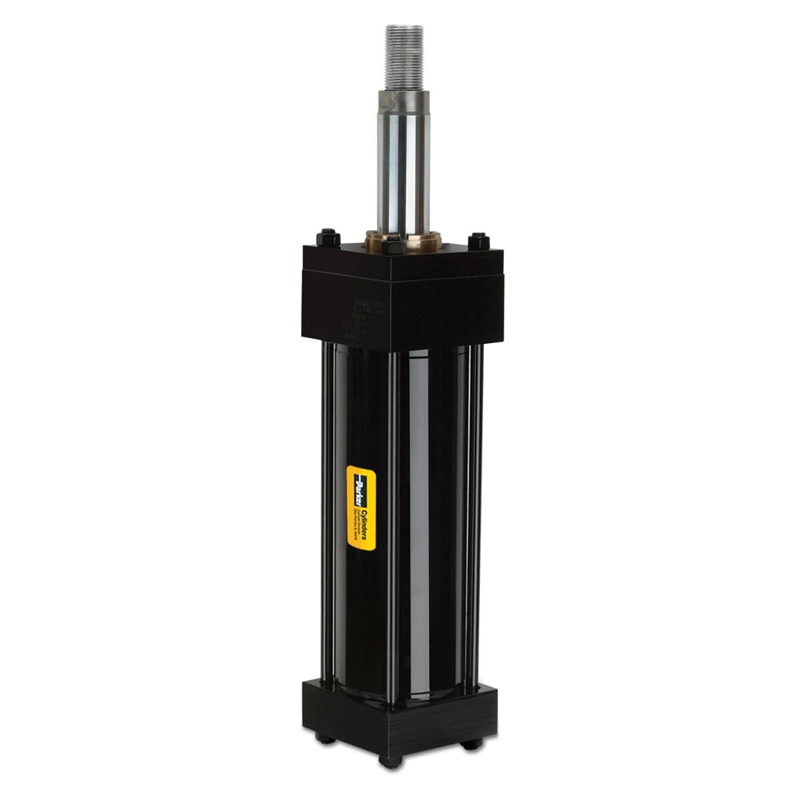
New Pneumatic Cylinder
Additional Features:-
Pressure control valves: These valves can be used to regulate the air pressure supplied to the cylinder, allowing for precise control of the force exerted by the piston rod.
Position sensors: Sensors like magnetic reed switches can be mounted on the cylinder to detect the position of the piston rod (extended or retracted). This is useful for automation and control applications.
Rod end options: Different rod end styles are available to accommodate various mounting configurations.
Benefits:-
Durability: Suitable for harsh environments and high-pressure applications.
Long service life: Hard chrome plated rod, high-quality seals, and robust design contribute to extended operation.
Low maintenance: Lubricated air operation helps minimize wear and tear.
Versatility: Wide range of bore sizes, stroke lengths, and optional features make it adaptable to various needs.
Performance: Precise control, efficient operation, and reliable force generation.
Fig 12: Parker Series 2A Pneumatic Cylinder

Slide 16
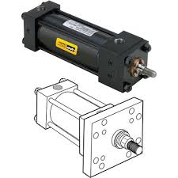
New Pneumatic Cylinder
Based on above study that has been discussed, cylinder of Parker series 2A can be considered for replacement of the existing cylinder.
Cylinder Model No.: 152.4CKJB2AR148M48MC50.80D11
Given below is a brief comparison of the existing cylinder with the
recommended one:
Piston Rod diameter is being increased from 44.5 mm to 50.8 mm.
Rod end threading is being increased from M33 to M45.
Bore and stroke are same.
Mounting style is same
NEW CYLINDER SPECIFICATIONS
CYLINDER COMPARISION
Mounting Style
Bore Diameter
Stroke Length
Rod Diameter
Rod End Style
Port
Port Position
Cushion
Square Flange(JB)
152.4mm
50.8mm
50.8mm
Style 8 (M45 x 2)
¾ BSPP
1
Head & Cap End
Parameters | Old Cylinder | New Cylinder
Rod Diameter | 44.5mm | 50.8mm
Effective Area | 16886.5mm | 16214.66mm
Dia. Of Min Sec | 28.5mm | 38.7mm
Hydraulic Force | 10011.7mm | 9728.7mm
Stress Generat. | 61.2MPa | 29.8MPa
Fig 13: Parker Series 2A Pneumatic Cylinder Setup and Model

Slide 17
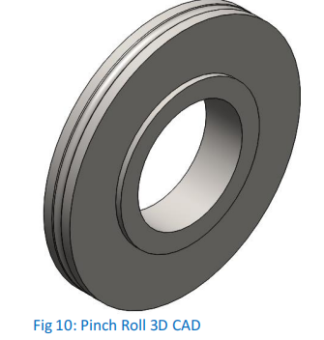
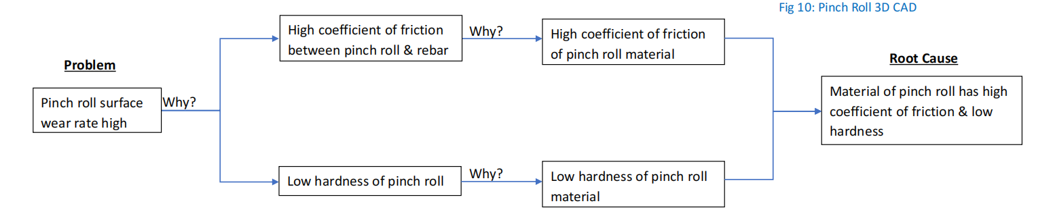
Pinch Rolls
Problem Analysis:
Bar braking pinch roll are used to slow down the rebars before entering the RES. These rebars are at a high temperature of about 400 °C.
Due to continuous operations at such a high temperature the pinch rolls start to wear out and the groove on the outer surface of the pinch rolls begins to enlarge overtime.
Worn out pinch rolls won’t grip the rebars properly which can cause bar
overshoot
Fig 14: Pinch Roll Design in SolidWorks
Fig 15: Root Cause Analysis for Pinch Rolls

Slide 18
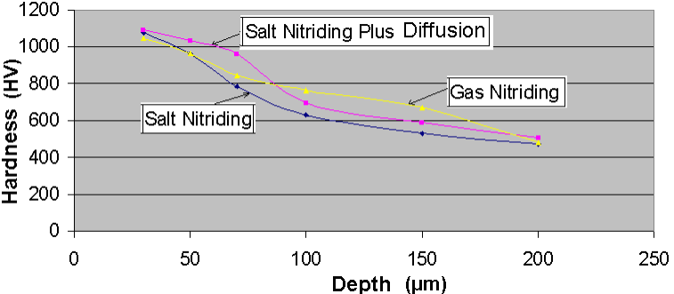
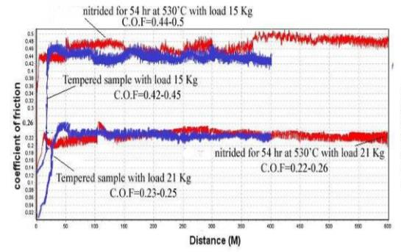
Recommended Solutions:
From the root cause analysis, we can infer that the major reasons for high wear rate of the pinch rolls is low
surface hardness and high coefficient of friction of pinch roll material. Therefore, the wear rate of pinch rolls can be reduced by:
Surface Hardening of the Pinch Rolls:
Surface Hardening increases the hardness of surface and also produces a smooth surface finish which slightly reduces the coefficient of friction.
Gas Nitriding can be selected as the preferred surface hardening process because of its superior wear resistance at high temperature and precise temperature control which leads to consistent and predictable
case depth and dimensional accuracy.
Gas Nitriding increases the hardness of the outer surface of pinch rolls from 55 HRC to approximately 68 HRC while keeping the core hardness constant.
It is expected to elongate the lifespan of pinch rolls by 20% - 30 %
Fig 16: Hardness profile of D2 steel for various nitriding process
Fig 17: Comparison of coefficient of friction of nitride D2 steel

Slide 19
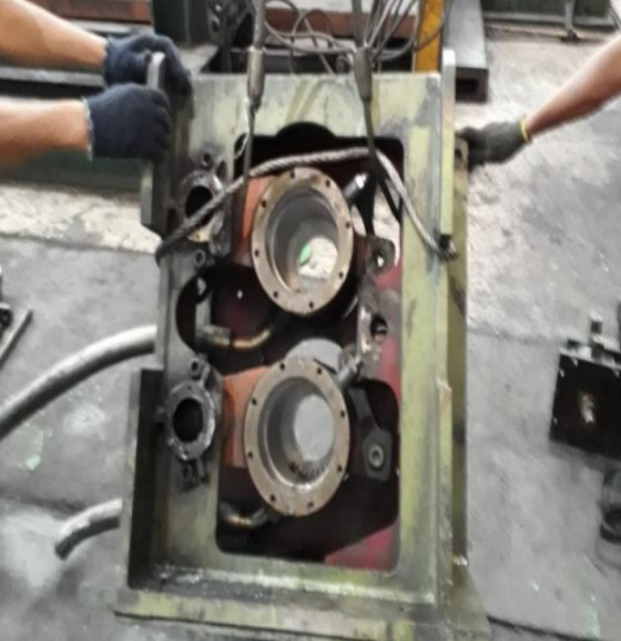
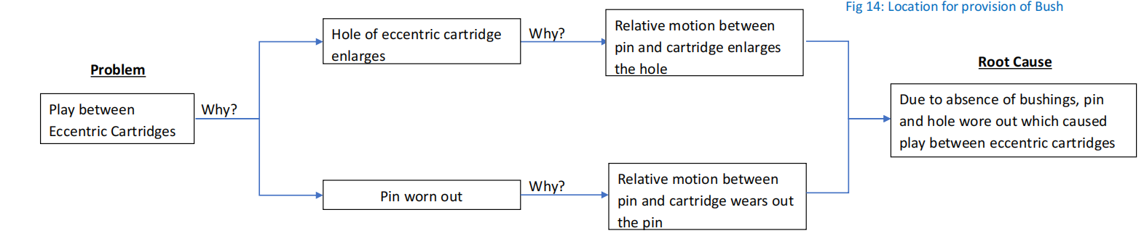
Eccentric Cartridges
Problem Analysis:
If play exists between the eccentric cartridges of the pinch roll assembly then the gap between the pinch rolls will not be uniform which will result in inefficient braking of rebars.
On close examination of the pinch roll assembly it was observed that the reason for this play is the wear and tear of the pin about which the eccentric cartridges pivot.
Wearing of pin reduces the MTBM cycle of the pinch roll unit
Modification is Required
Fig 18: Location for provision of Bush
Fig 19: Root Cause Analysis for Eccentric Catridges

Slide 20
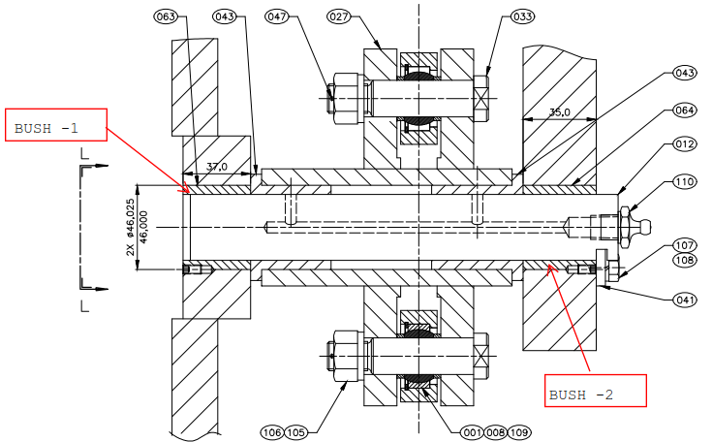
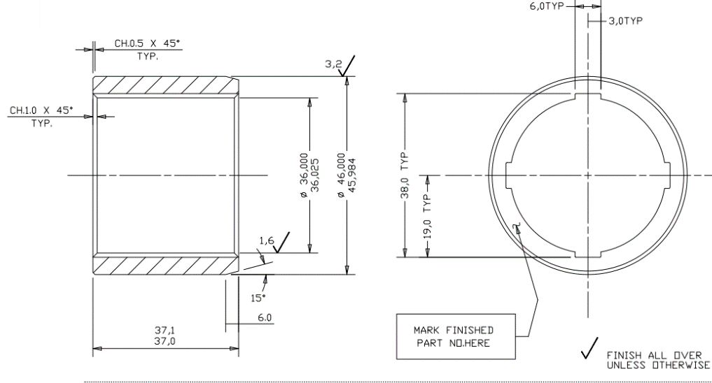
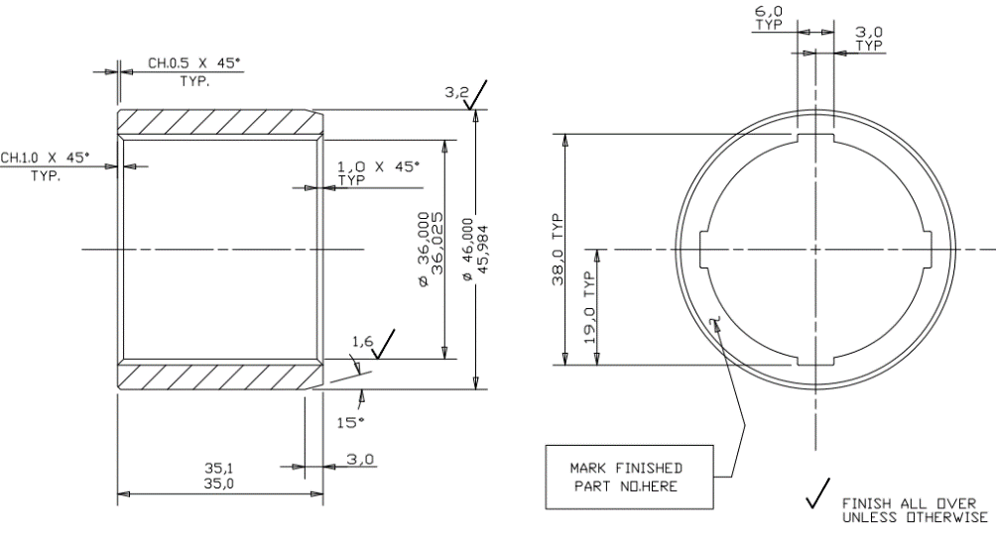
Recommended Solutions:
From the root cause analysis, we can infer that bushings are required to be installed between the pin and eccentric cartridge. Therefore, the play between the cartridges can be eliminated by the:
Use of Bush between Pin and Cartridge:
• By using a bush we can ensure that the pin won’t wear and hole of the eccentric cartridge won’t enlarge.
• Replacement of the bush would also be more convenient and cost efficient as compared to replacement of pin.
• Therefore, overall downtime of the mill will be reduced and the monetary losses incurred would also be minimised.
• The material of the bushings is: UNS F13101 (ASTM A48)
Fig 19: Cut Section of Pin with bushes added
Fig 20: Drawing Bush 1
Fig 21: Drawing Bush 2

Slide 21
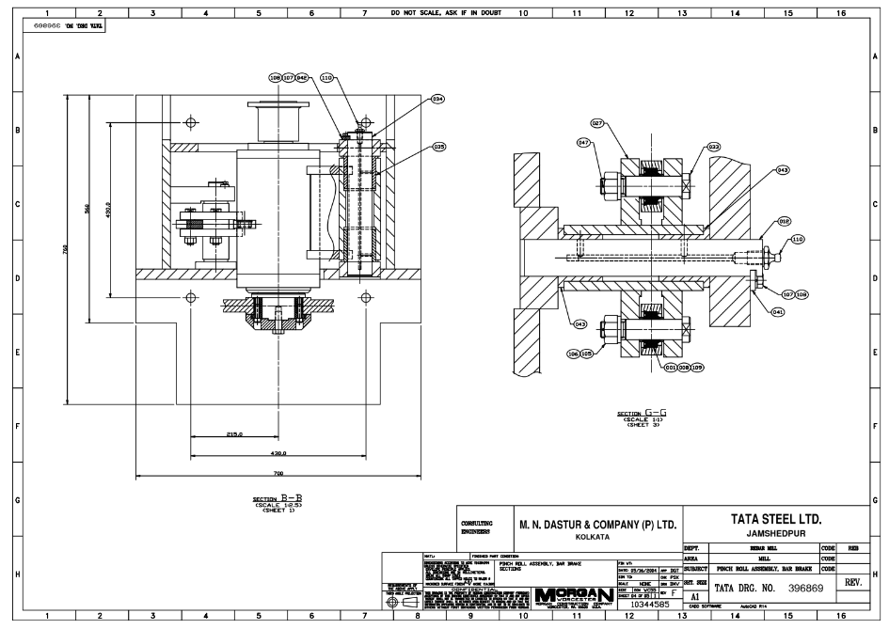
Eccentric Cartridges
Fig 22: Overview Drawing of Cut Section of Bushes Added, Drawn in AutoCAD

Slide 22
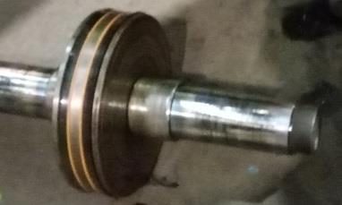
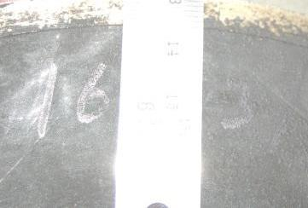
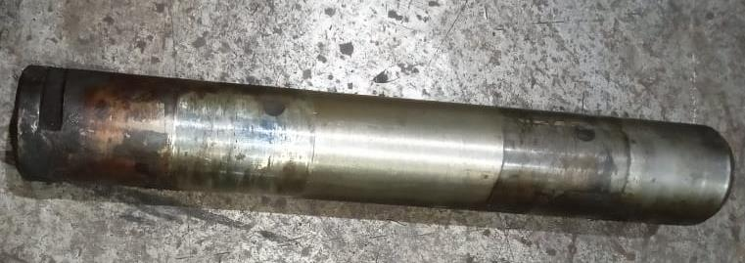
Summary
Component | Piston Rolls | Pinch Rolls | Eccentric Cartridges
Problem Definition
Root Cause | Bending forces acting on the piston rod due to improper assembly of the cylinder causing it to fail prematurely from the neck of the threading. | Material of pinch roll has low surface hardness. | Due to absence of bushings, pin and hole wore out which caused play between eccentric cartridges.
Recommended Solution | 1. Increase Piston Rod Diameter 2. Improve Assembly Procedure 3. New Piston Rod Inspection | Surface Hardening of Pinch Rolls (Gas Nitriding) | Use bushings between pin and cartridge (Material: UNS F13101)

Slide 23
Thank You

